Slide 1



Atliq Hardware
Consumer Good Ad-hoc Insights
Presented by – Md Sahil
February 2023
SQL Project Challenge

Slide 2

Agenda
Introduction and Goal
Discussion about data
Analyzing and answering the given request Problem
Conclusion

Slide 3

Introduction
Atliq Hardwares is one of the leading computer hardware producers in India and well expanded in other countries too.
The management to get enough insights of their Products and customer to make quick and smart data-informed decisions, they have given 10 ad-hoc requests.
In this study I have used SQL Query to find the answers of their requests in order to find the insights of their Products and Customers.

Slide 4
Discussion about data
There are following data from year 2018 to 2022 which are given by organization –
Customer-related data
Product-related data
Gross price information for each product
Information about the cost incurred in the production of each product
Pre-invoice deductions information for each product
Information about monthly sales data for each product

Slide 5
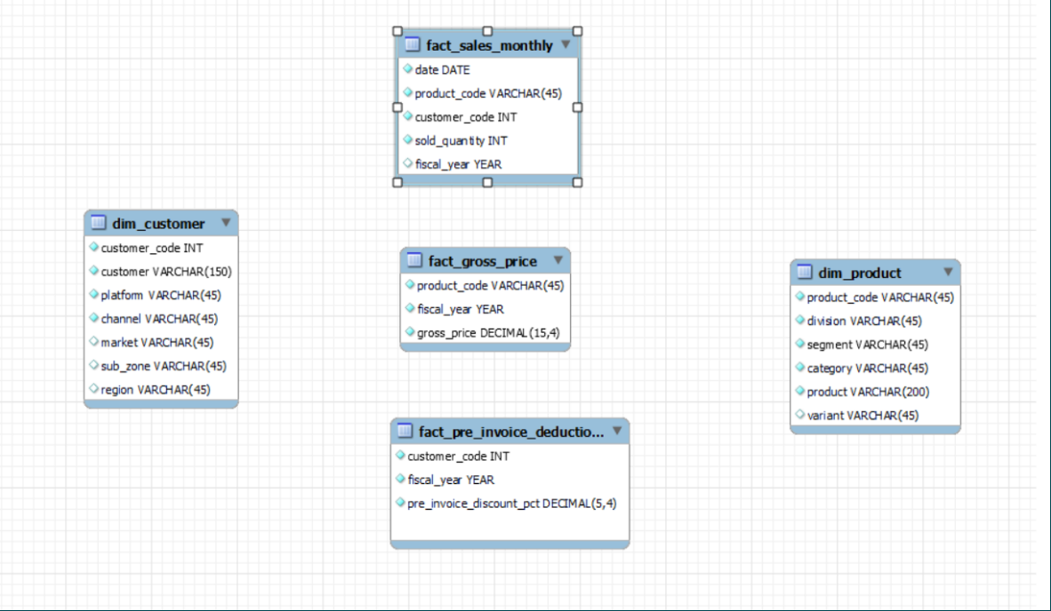
Structure of the data table

Slide 6
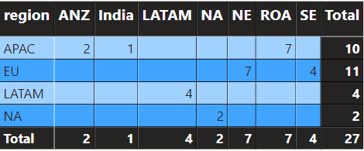
Information about Customer and region
There are 74 distinct customer presents from different market-country, sub-zone and region
There are 27 distinct market country exist.
There are 7 distinct sub zone exist - 'India’, 'ROA’, 'ANZ’, 'SE’, 'NE’, 'NA', and 'LATAM’
There are 4 distinct region exist - 'APAC', 'EU', 'NA' and 'LATAM’
Count of number of market country in each subzone and region given below:

Slide 7
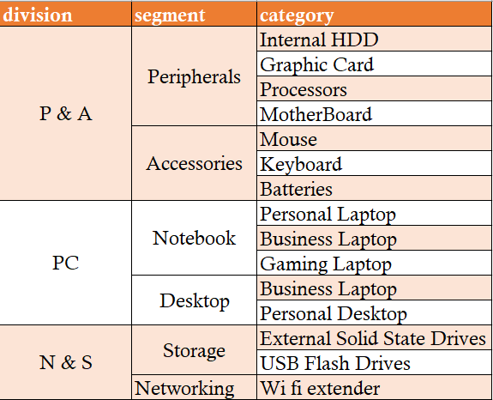
Information of Products Category

Slide 8

Ad-hoc requests and Analyzation

Slide 9
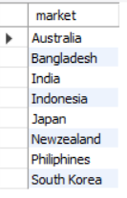
Request – 1:
Provide the list of markets in which customer "Atliq Exclusive" operates its business in the APAC region.

Slide 10

Request – 2:
What is the percentage of unique product increase in 2021 vs. 2020?
The final output contains these fields,
unique_products_2020
unique_products_2021
percentage_chg

Slide 11
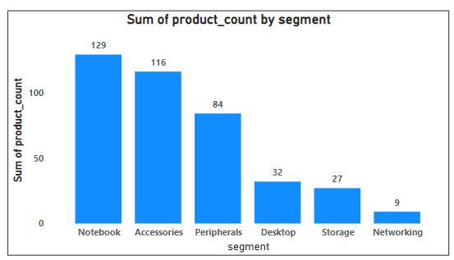
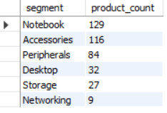
Request – 3:
Provide a report with all the unique product counts for each segment and
sort them in descending order of product counts.
The final output contains 2 fields,
segment
product_count
Insight:
Number of unique Product in network segment is very less.

Slide 12
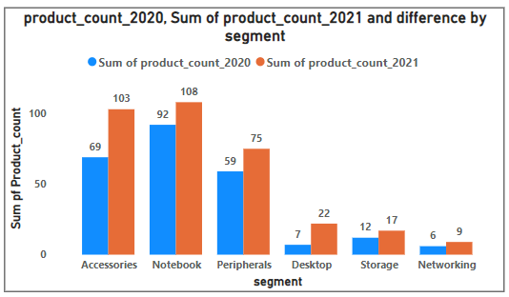
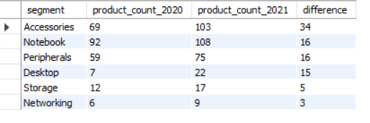
Request – 4:
Follow-up: Which segment had the most increase in unique products in 2021 vs 2020?
The final output contains these fields,
segment
product_count_2020
product_count_2021
difference

Slide 13

Request – 5:
Get the products that have the highest and lowest manufacturing costs.
The final output should contain these fields,
product_code
product
manufacturing_cost
Highest Manufacturing Cost
Lowest Manufacturing Cost

Slide 14
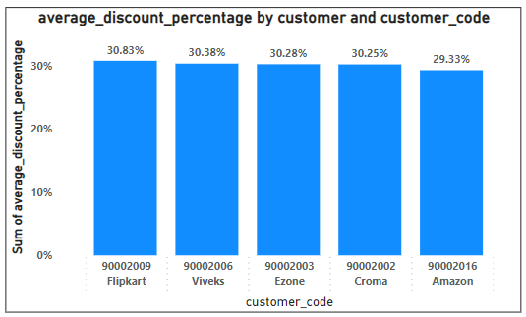
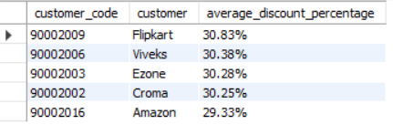
Request – 6:
Generate a report which contains the top 5 customers who received an
average high pre_invoice_discount_pct for the fiscal year 2021 and in the Indian market.
The final output contains these fields,
customer_code
customer
average_discount_percentage
Insight:
Average discount Percentage of top 4 customer more or less same except Amazon. Although it is also very small. In Amazon average discount percentage differs from more or less 1% from others 4. For example, from Croma it differs 0.93% and from Flipkart it differs 1.5%.

Slide 15
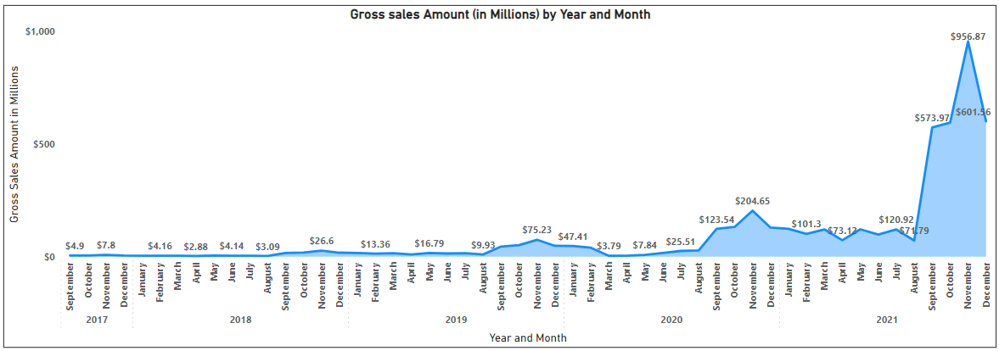
Request – 7:
Get the complete report of the Gross sales amount for the customer “Atliq Exclusive” for each month. This analysis helps to get an idea of low and high-performing months and take strategic decisions. The final report contains these columns:
Month
Year
Gross sales Amount

Slide 16
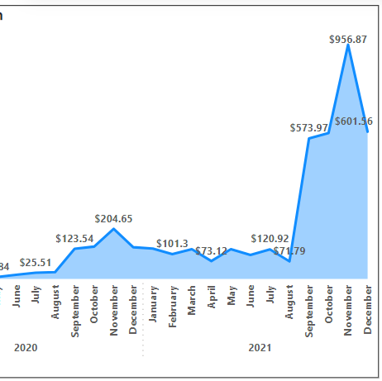
Highest selling month
Most selling months
Insight:
It seems that gross sales from September to Next February little bit higher than other months. Also, gross sales went to peak in end 2021(from September). And November is most selling month in every year.
November 2021 is most selling month.

Slide 17
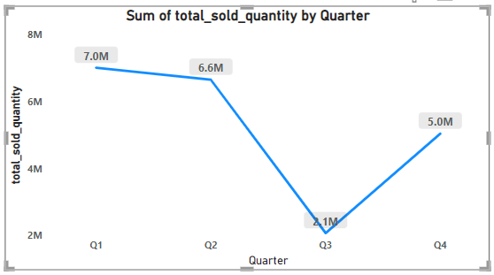
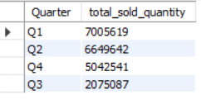
Request – 8:
In which quarter of 2020, got the maximum total_sold_quantity?
The final output contains these fields sorted by the total_sold_quantity,
Quarter
total_sold_quantity
Insight:
Total Sold quantity in 2020 Q3 is very less.
Total sold quantity decreasing with each quarter.
Q1 has maximum total sold quantity and Q3 has minimum total sold quantity.

Slide 18
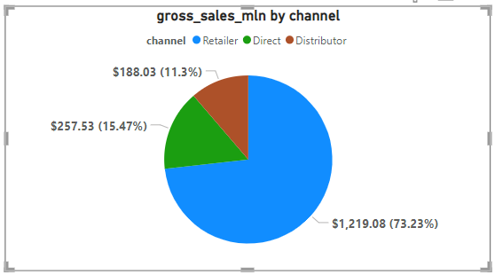
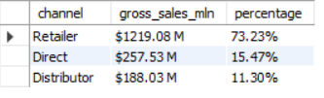
Request – 9:
Which channel helped to bring more gross sales in the fiscal year 2021
and the percentage of contribution? The final output contains these fields,
channel
gross_sales_mln
percentage
Insight:
In 2021, maximum gross sales comes from Retailer and less sales comes from distributor.

Slide 19
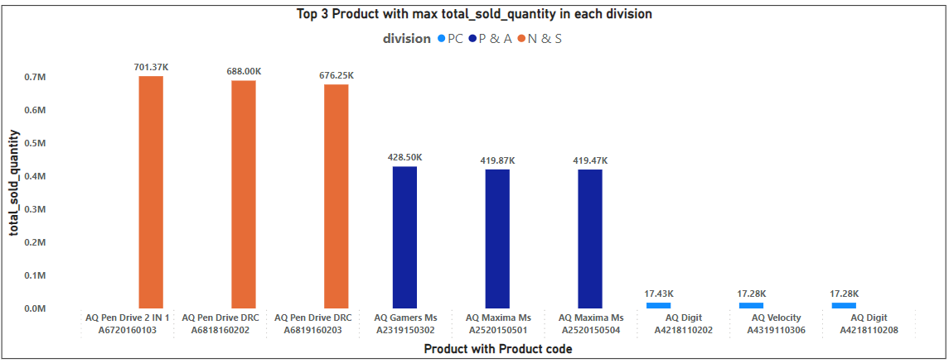
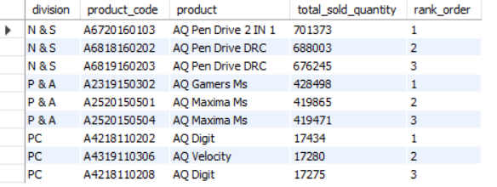
Request – 10:
Get the Top 3 products in each division that have a high total_sold_quantity in the fiscal_year 2021? The final output contains these fields,
division
product_code
product
total_sold_quantity
rank_order
Insight:
Sold quantity of products from PC division is extremely less in 2021.
Sold quantity of products from N & S division is maximum in 2021, whereas sold quantity of products from P & A division is moderate.

Slide 20
Conclusion
Number of unique Product in network segment is extremely less. Storage and desktop section is also less than others segment. So, Need to increase products in these categories according sales.
Flipkart received average highest pre invoice discount percentage for the fiscal year 2021 in the Indian market. So, for Indian market Atliq Hardware needs to focus on Flipkart.
It seems that gross sales from September to Next February little bit higher than other months. Also, gross sales went to peak in end 2021(from September). And November is most selling month in every year. So, Company needs to focus on end of a year and start of a year specially in November month.
In 2021, maximum gross sales comes from Retailer and less sales comes from distributor. So, Company needs to more focus on Retailer channel.
Sold quantity of products from PC division is extremely less in 2021 whereas, Sold quantity of products from N & S division is maximum in 2021. So, Company needs to more product stocks in N & S division.

Slide 21


